Slide 1
Spring 2023 BoD Meeting
Jim Gillcrist / Executive Director
27 April 2023

Slide 2
Naval Helicopter Association, Inc. Historical Society (NHAHS) Report
Thursday, 27 April 2023
CAPT Bill Personius, USN (Ret.)
President/CEO NHAHS

Slide 3
NHAHS Treasurer’s Report

Slide 4
NHAHS Projects for 2023
NHAHS Website Maintenance and Upkeep On-Going
USS Midway – Helicopter Exhibit and Readyroom 2 Maintenance On-Going
Helicopter Designation Number Project On-Going
Mark Starr Awards 2023 On-Going
CAPT Joellen Drag Oslund, USNR - Present at Symposium
Mark Starr Award/Scholarship 2023 In Work
NNAM Pensacola HH-60H Standby
Fund Raising $25,000.00 - Goal Reached
On Hold awaiting information from NNAM PCola

Slide 5
NHAHS Projects for 2023
Charity Golf Tournament with Scholarship Fund In Work
Helix Cup Being Defended by HSM-41 at Symposium Wednesday 17 May
Golden Helix Designation - VADM Jeff Hughes, USN On-Going
Standing by for Next Recipient
Oldest Helix - CAPT “Scratch” Haskernatch, USN (Ret.) - 93 On-Going
In an Attempt to be More Inclusive:
Golden Crew Chief - AWSCM Steve Turo, USN In Work
Will Recognize at Symposium
Silver Crew Chief - Oldest Living Aircrewman “Red Dog” Moss In Work Will Mention at Symposium

Slide 6
NHAHS Projects for 2023
Flag Circle - In Kind Consideration Support - 3 Wash Jobs, H-3 Painted On Going
HC-7 Movie - Script is written, 2 sets interviews done, CGI on contract On Going
Looking for Funding for the Remainder of the Project
Jack Rabbits to Jets/NASNI History Book - Lost Contact with Author On Hold
Hank Caruso Helicopter Caricatures Book - Coordinating the Effort In Work
SH-60F Lassen Display - Authorization Approved In Work
Aircraft Paid For
Picked-Up Aircraft from Davis Monthan 24 April
Aircraft is in USS Midway Restoration Hangar 805 Friday 16 Jun Dedication Ceremony - Unachievable
Other Dates 16 Oct, 16 Jan, 19 Jun, etc.

Slide 7
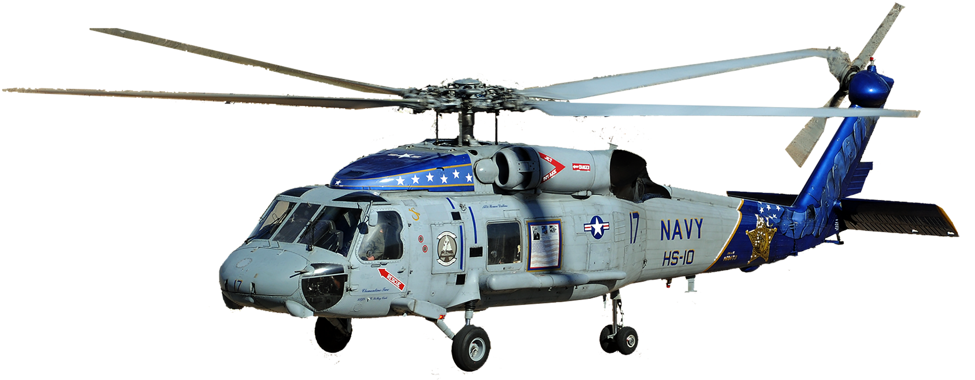
Lassen SH-60F Project
Aircraft is on North Island
Restoration Has Begun
Money Raised To Date $85K - $20K (Aircraft) = ~$65K
Airframe Engineering, Stanchion Construction, Memorial, and Mounting = ~$250K+
Need Commitment from NHA that this is Important! – (otherwise this will sit in the garage)
- Propose Capital Campaign to Raise $250K by the end of 16 June 2024
BOD, Trustees, Flags/Retired Flags need to help make this happen!
Propose a Lead Agent and Committee to Manage the Capital Campaign

Slide 8
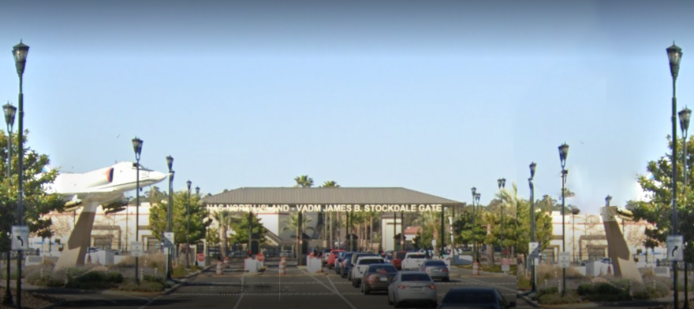
Stockdale Entrance with SH-60F on a Pedestal
Computer Rendition
Notes:
Here is a computer rendition of what we expect the aircraft to look like when the helicopter is mounted.

Slide 9
Any Questions?

Slide 10
$250K Capital Campaign
History
$85K Raised - $20K Aircraft = $65K On Hand $185K to Go!
3 Feb 2021 Start Date
7 June 2021 Strike Board Approval for Aircraft 4 Months
3 March 2023 ASN EIE Approval 2 Years
25 Apr 2023 Aircraft Arrives NBC (NASNI) 2 Years

Slide 11
How Do We Get To Mission Complete/$~185K?
16 (13) Oct 2023 80 Years of Naval Helicopters 5 Months $37K/Month 2.8
16 (12) Jan 2024 55 Year Anniversary of MOH 9 Months $21K/Month 3.0
19 (14) Jun 2024 56 Year Anniversary of Rescue 12 Months $16K/Month 3.5
16 (11) Oct 2024 81 Years of Naval Helicopters 15 Months $13K/Month 3.8
16 (17) Jan 2025 56 Year Anniversary of MOH 18 Months $11K/Month 4.0
19 (18) Jun 2025 57 Year Anniversary of Rescue 23 Months $8K/Month 4.5

Slide 12
Commitment
NHA BOD - $
U$$ Midway - Management / Planning / Supervision / Material$
Wing - Manpower
Base - Involvement / Support / Coordination / PAO / Dedication Ceremony (ORF)
Fundraising Team and POC
Coordination - NHAHS
This is a Big Deal!
Pay Appropriate Honor and Respect to a MOH Recipient
Do Not Want to Embarrass Ourselves or USN!

Slide 13
Major Donor List
Sikorsky $25K
GE $10K
Midway $20K + Shipping/Engineering Work/Restoration
NHA $3.5K
$60.5K + $20K Individual Donations

