Slide 1
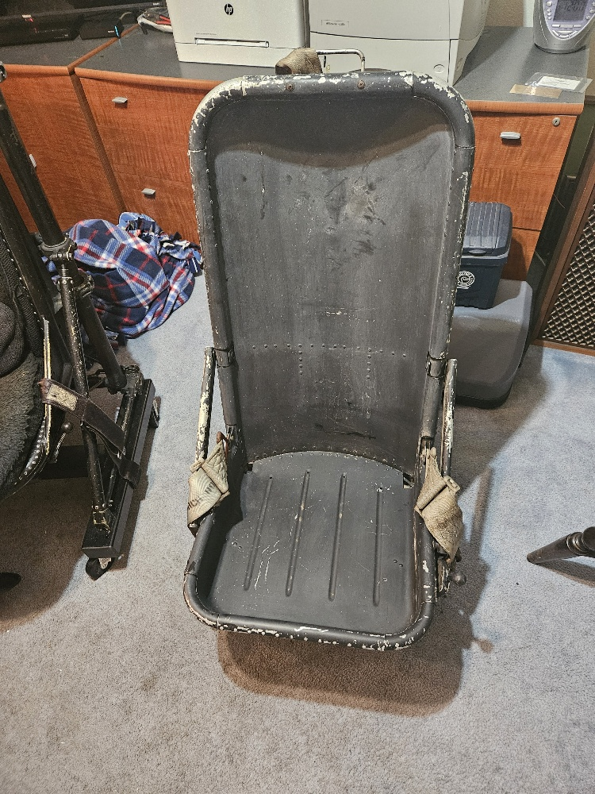
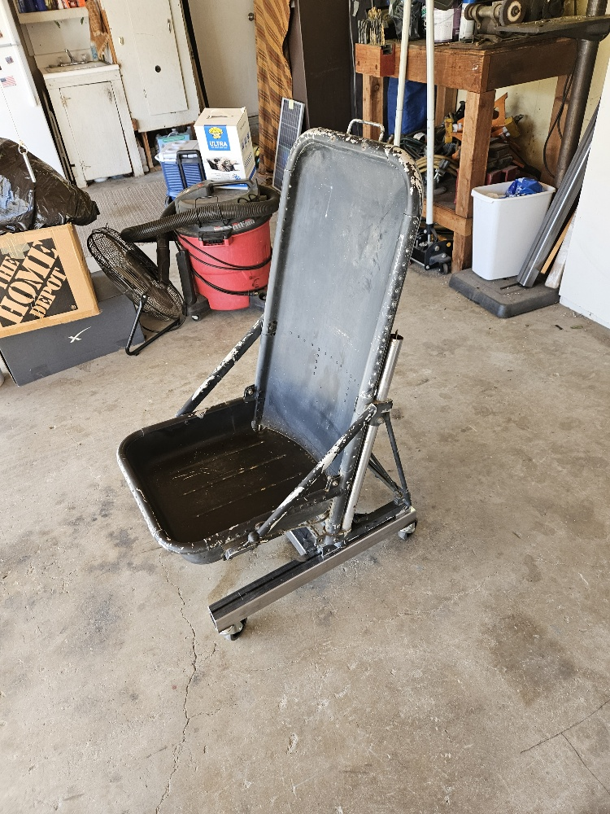
Navy Helicopter Pilot/Crew Seat SH-3A/D/G/H SeaKing/ USCG HH-3F Pelican & USAF HH-3C/E Desk Chair Conversion Required Materials and Instructions
1each-2"x2“ x 72”x13 ga Mild Steel Square Tube(62” needed)
4 each 3/8/16 course thread Weld Nut Insets
4 each 3” stem casters with 3/8/16 course thread
2 each 3/8/16 x 1”course thread Bolts
2 each 3/8/16 x 2 ½ course thread Bolts
4 each 3/8/16 course thread Nylock Nuts
Rustoleum Spray Paint-Primer Gray and Gloss Black or your personal choice of color
4 each 2”x2” Square Tubing Plastic Plug/End Cap 2”x2”-Black in color
Cut the steel into 3 pieces for your pilot chair framework:
2 each-24”x2”x2”
1 each-13 3/16”x2”x2”
H

Slide 2
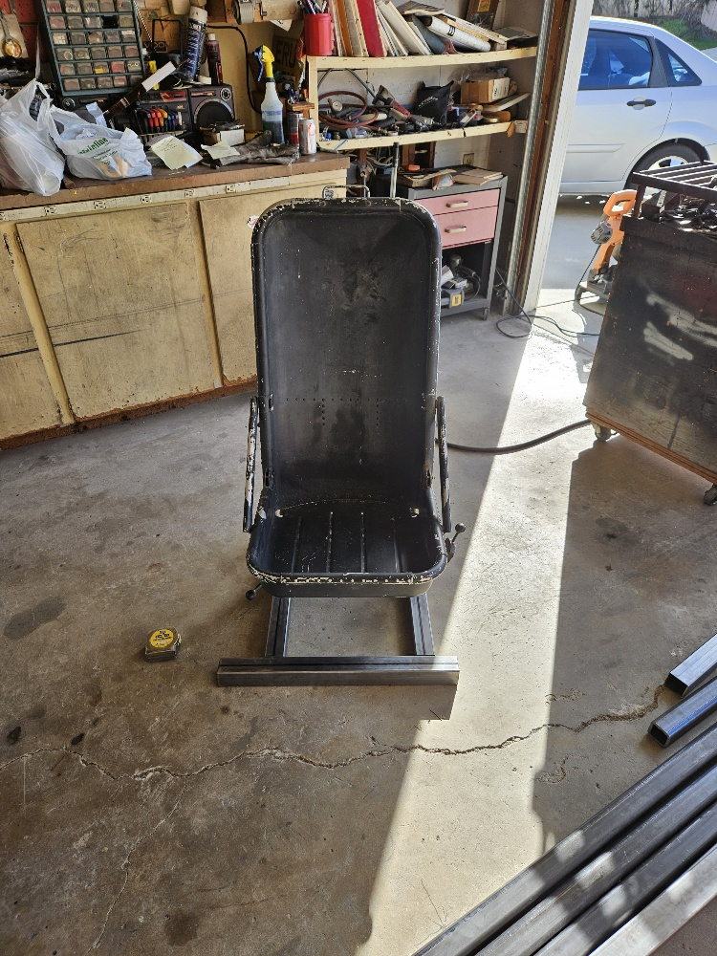
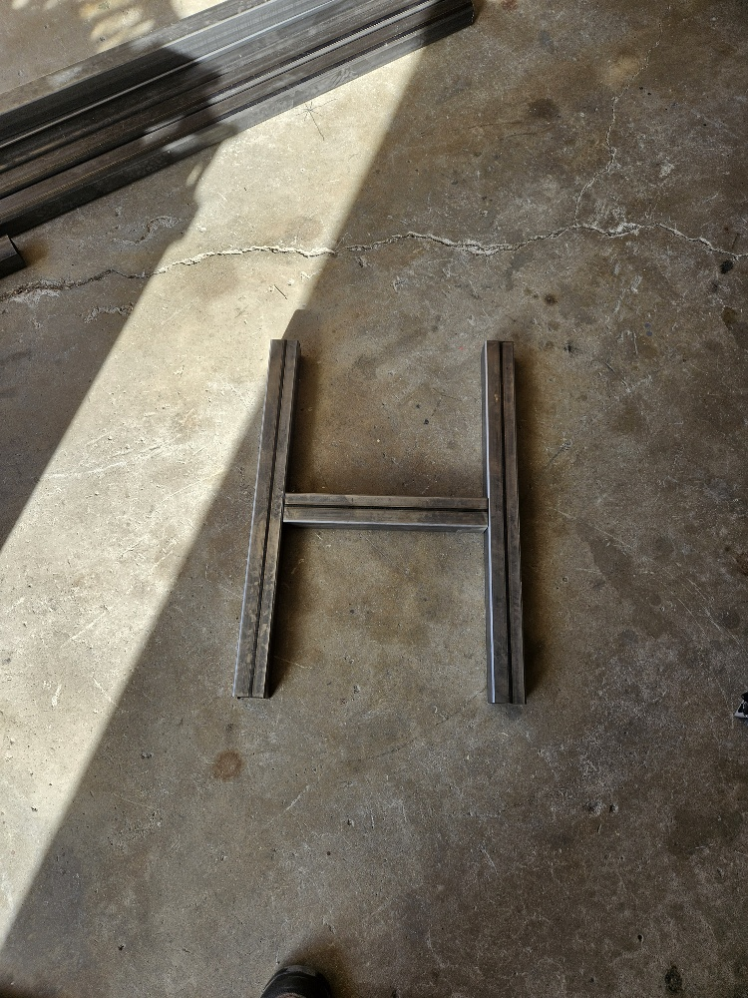
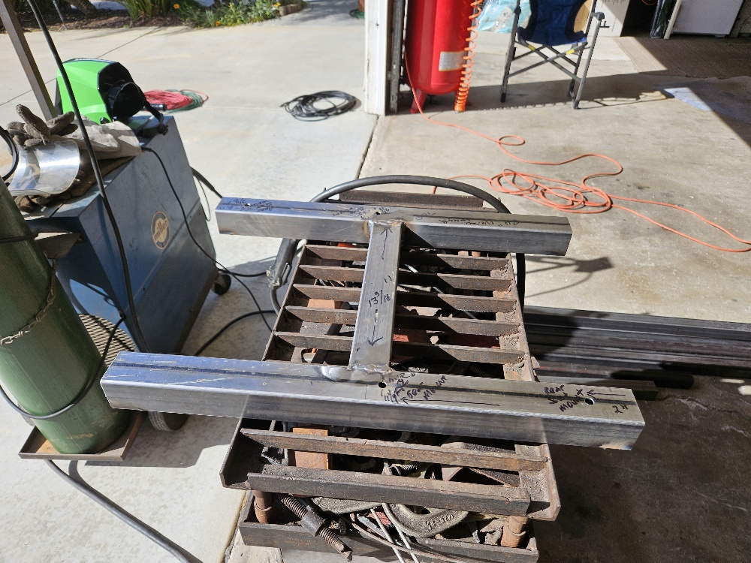
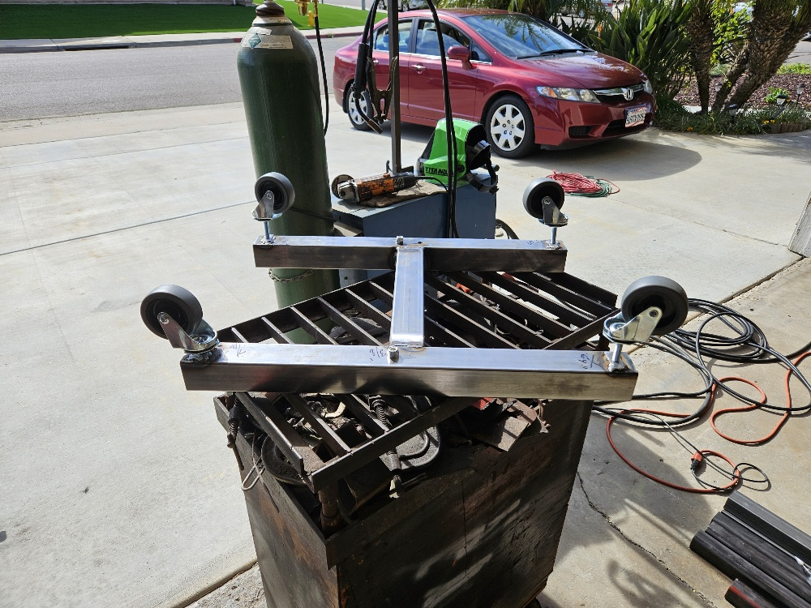
On each 24” piece, drill the underside in 4 places using a diameter drill to allow the weldnut to be placed into it. Make sure these holes are centered and are at least ¾ “ from each tube end for the attachment of the stem casters. Insert the weld nuts and weld them in place. Clean up your welds with a grinder.
Weld the three pieces together in a “H” Shape with the 2 legs of the H being 24 “ long and the center piece of the H, 13 3/16 “ long welded centered between both legs of the H. Cleanup your tubing welded joints and tubing ends with a grinder.
Once the H Shape is welded together, place the pilot seat on the H frame centered left to right with the back of the seat frame slightly forward such that the top holes are at least ¾” from the end. Mark the positions for the top back holes and then the front top holes. Use a drill one size larger than 3/8’ diameter to drill all four holes. The picture below shows the four slotted seat tracks on the underside of the seat framework which the 3/8” bolt head will fit into in order to attach the seat to the framework.
Once drilling has been completed, clean any grease/oil off the framework; complete any finish grinding and paint, using Rustoleum primer and paint of your color choice, although we used black. Once the paint is dry, these top holes will accept a 3/8/16 x 1’ bolt each with the head on top of the frame and the bolt fitting into the hole and the 3/8” Nylock attached on the bolt inside of the tubing. Tighten each bolt down but leave a good 3/8” of play so the bolt head will be able to stick up and enter the H-3 track. Once the seat is positioned with the four bolt heads in the seat track, the bolts can be tightened to hold the seat to the framework. The four stem casters can then be threaded into the underside weld nuts until they are tight. I used a very large screwdriver head to wedge the bolt head in the track so I could tighten down each Nylock nut with an open head wrench.
Install your steel tubing plastic plugs in the ends of each channel on the H part of the framework. May need a plastic mallet to tap them into the conduit.

Slide 3
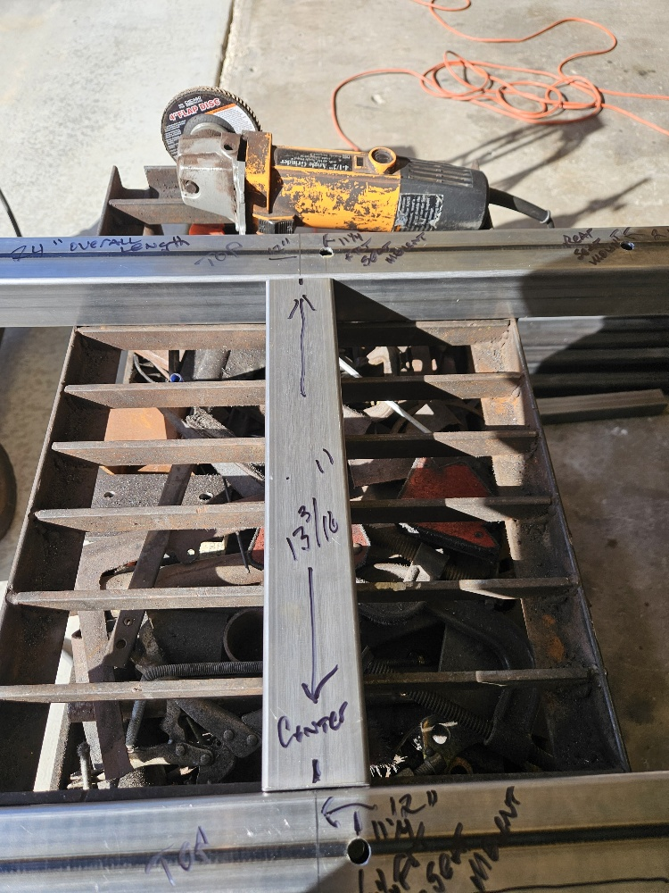
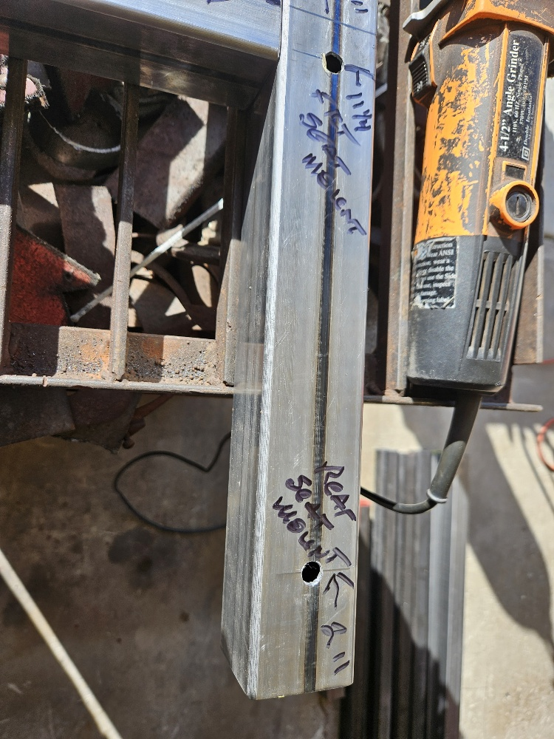
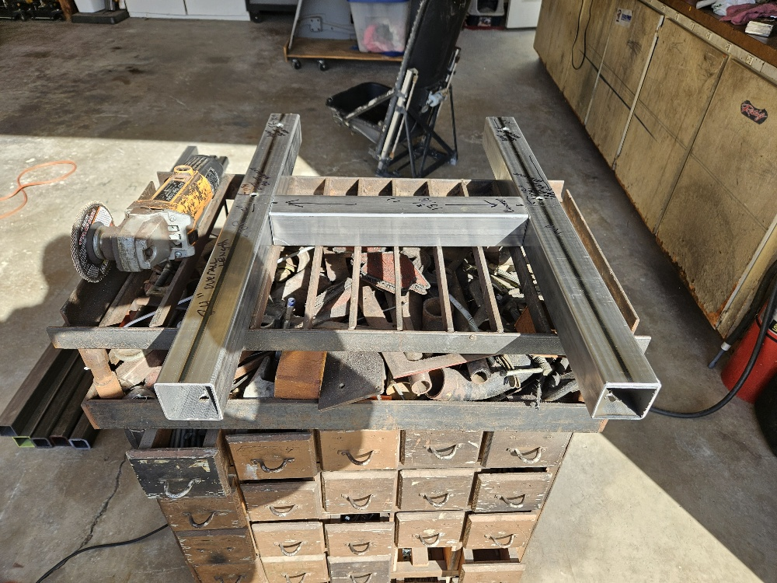
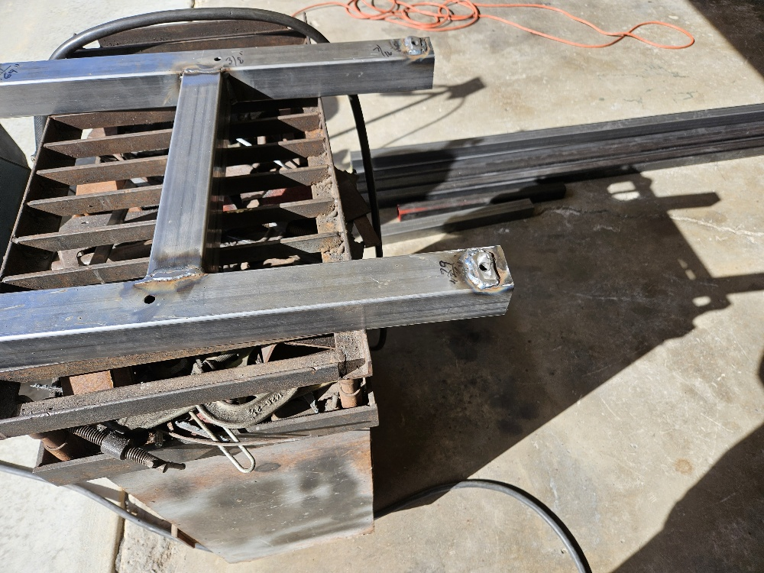
You will need a Chop/Cutoff saw to cut your steel and suitable welder to formally attach the three pieces of steel and weld in the weld nut inserts. The middle picture shows some weld nuts intended for stem caster installation on the underside of the frame and samples of the bolts used for the formal attachment of the seat to the top of the frame. Use actual Nylock nuts on those four seat attachments.
Seat Cushions and Seat Back Cushion foam dimensions roughly(starter) are:
Seat cushion foam-18 ¾ “ Front to Back x 16 ¼” Width x 8” thick
Seat back cushion foam dimention-30 ½ “ tall x 16 ¼ “ wide and roughly 5” to 6” thick.
H-3 Pilot Seat Paint Rust-Oleum® Industrial Spray Paint - ANSI 61 Light Gray

Slide 4
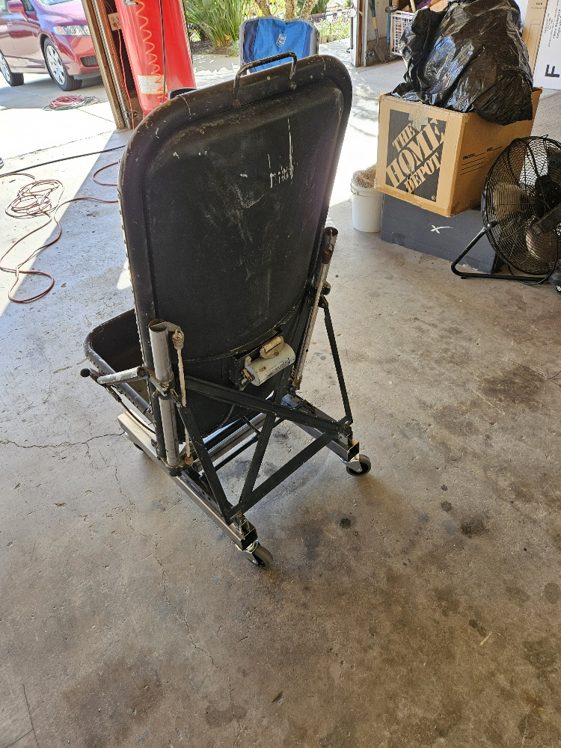
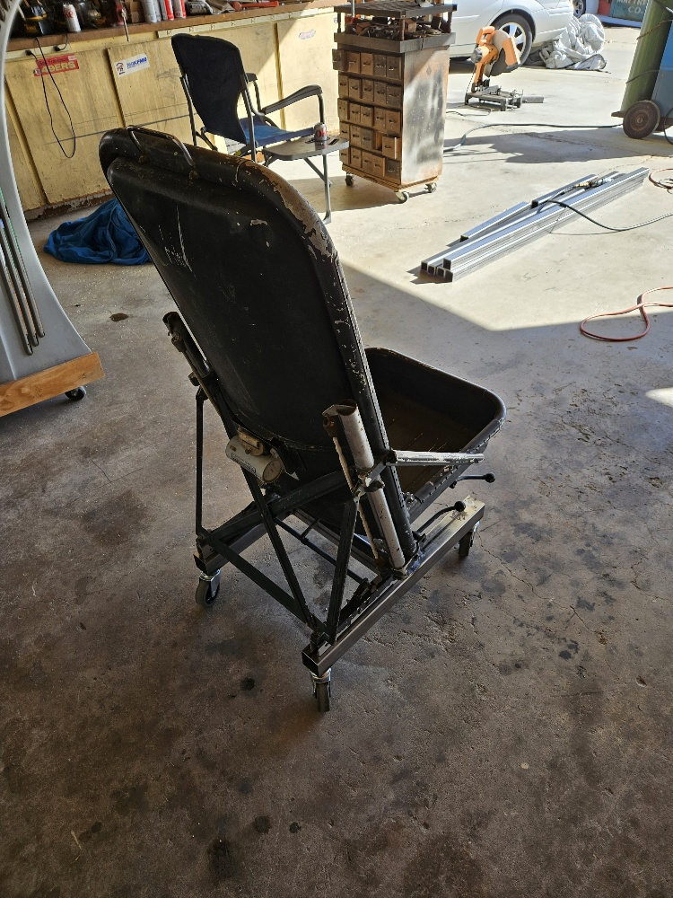
In this picture, you can see the black plastic 2x2 Plastic Plugs which we used. We used 2x2 steel on the initial chairs but 2x2 steel will save a little money.

